Slide 1
Law of obligation in Muslim law

Slide 2
Contents of them
1. Peculiarities of law of obligation in Muslim law.
2. Types of obligations in Muslim law.
3. Contract of sale and purchase.
4.Donative contract

Slide 3
Peculiarities of law of obligation in Muslim law
Obligation
(n.) Any act by which a person becomes bound to do something to or for anouther, or to forbear something; external duties imposed by law, promise, or contract, by the relations of society, or by courtesy, kindness, etc.
(n.) The act of obligating.
(n.) A bond with a condition annexed, and a penalty for nonfulfillment. In a larger sense, it is an acknowledgment of a duty to pay a certain sum or do a certain things.
(n.) That which obligates or constrains; the binding power of a promise, contract, oath, or vow, or of law; that which constitutes legal or moral duty.
(n.) The state of being obligated or bound; the state of being indebted for an act of favor or kindness; as, to place others under obligations to one.

Slide 4
Peculiarities of law of obligation in Muslim law
An obligation is a course of action that someone is required to take, whether legal or moral. There are also obligations in other normative contexts, such as obligations of etiquette, social obligations, and possibly in terms of politics, where obligations are requirements which must be fulfilled. These are generally legal obligations, which can incur a penalty for non-fulfilment, although certain people are obliged to carry out certain actions for other reasons as well, whether as a tradition or for social reasons. Obligations vary from person to person: for example, a person holding a political office will generally have far more obligations than an average adult citizen, who themselves will have more obligations than a child.^{[1]} Obligations are generally granted in return for an increase in an individual's rights or power. For example, obligations for health and safety in a workplace from employer to employee maybe to ensure the fire exit isn't blocked or ensure that the plugs are put in firmly.
The word "obligation" can also designate a written obligation, or such things as bank notes, coins, checks, bonds, stamps, or securities.

Slide 5
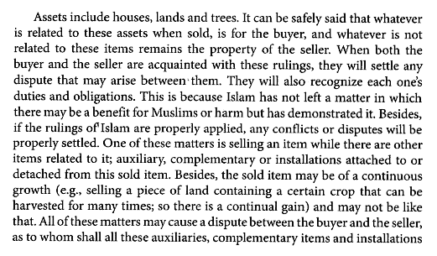
Types of obligations in Muslim law

Slide 6


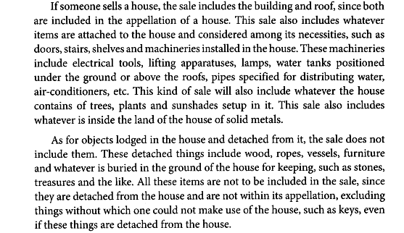

Slide 7
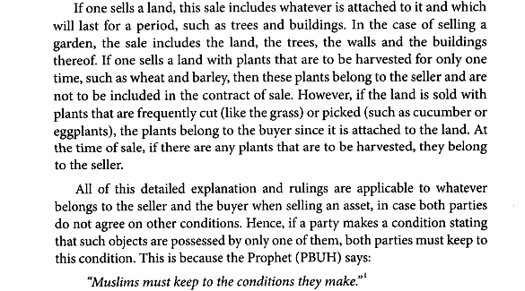

Slide 8

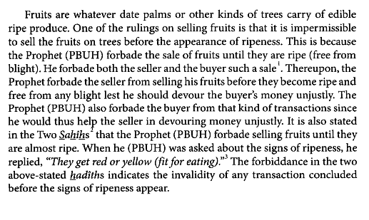

Slide 9
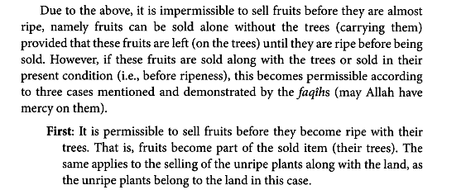

Slide 10
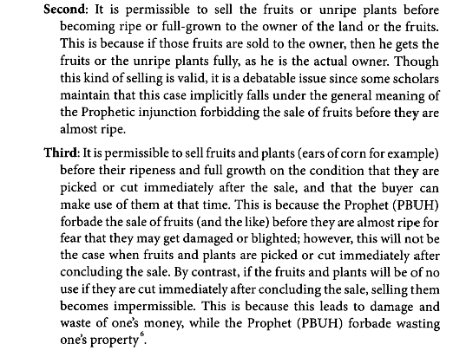

Slide 11

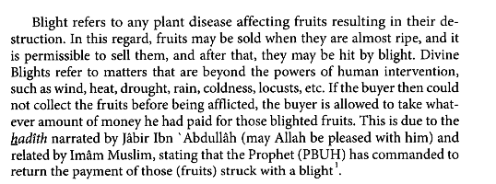

Slide 12
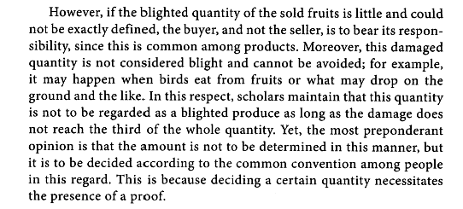

Slide 13

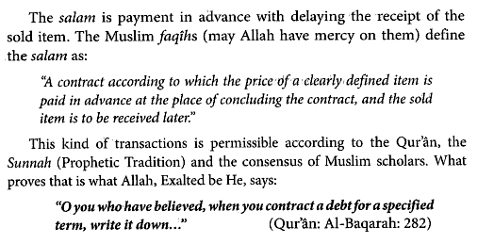

Slide 14
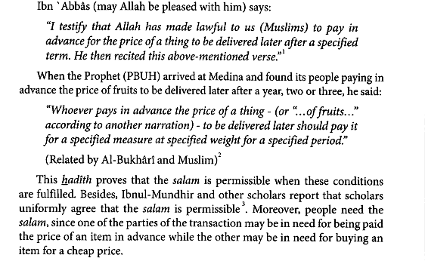

Slide 15

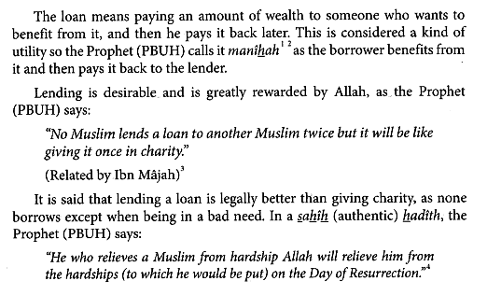

Slide 16

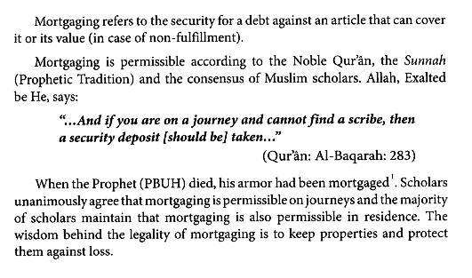

Slide 17

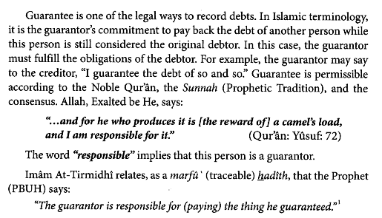

Slide 18
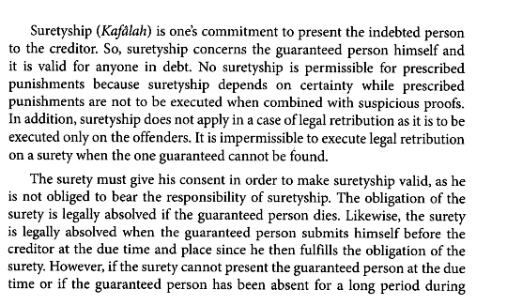

Slide 19

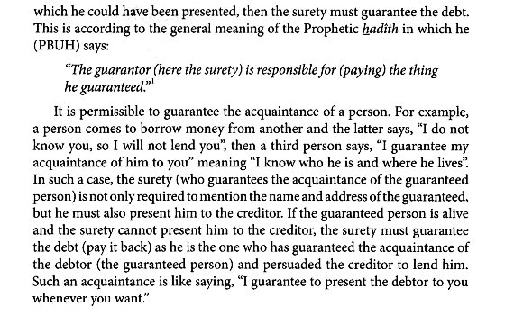

Slide 20
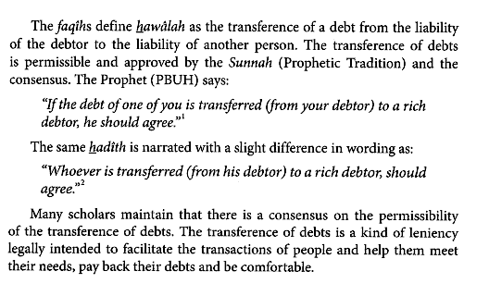

Slide 21
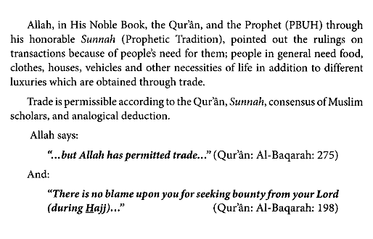
Contract of sale and purchase.

Slide 22
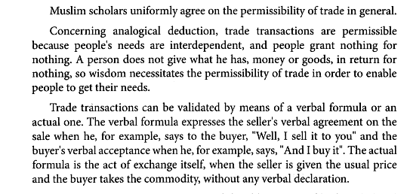
Contract of sale and purchase

Slide 23
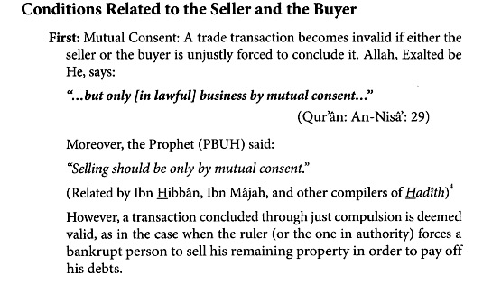
Contract of sale and purchase

Slide 24
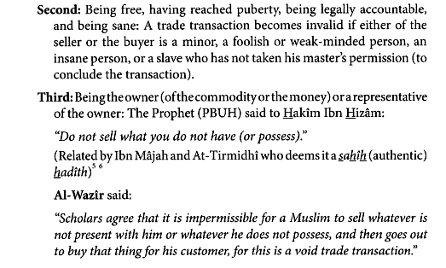
Contract of sale and purchase

Slide 25
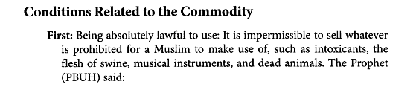
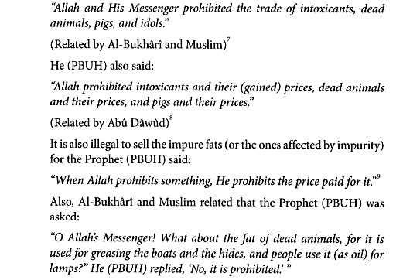
Contract of sale and purchase

Slide 26
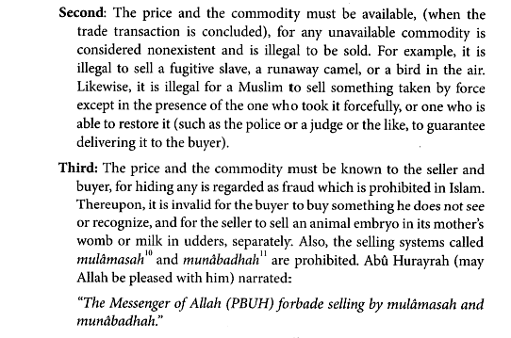
Contract of sale and purchase

Slide 27
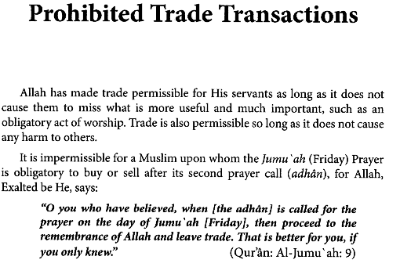
Contract of sale and purchase

Slide 28

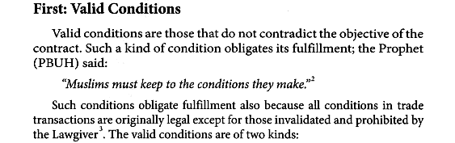
Contract of sale and purchase

Slide 29
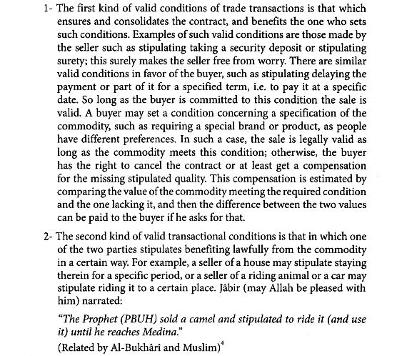
Contract of sale and purchase

Slide 30
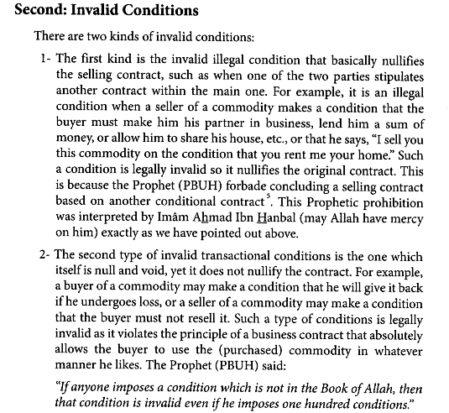
Contract of sale and purchase

Slide 31
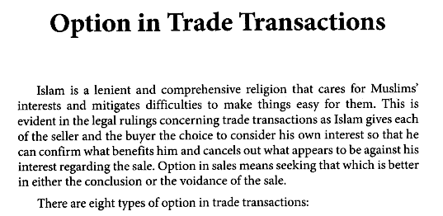
Contract of sale and purchase

Slide 32
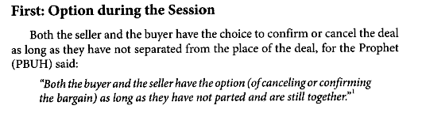
Contract of sale and purchase

Slide 33
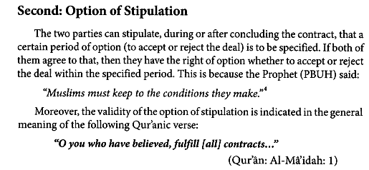
Contract of sale and purchase

Slide 34
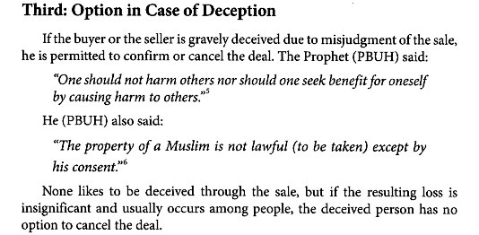
Contract of sale and purchase

Slide 35
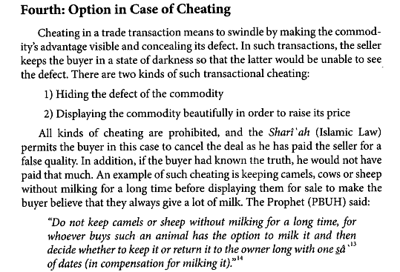
Contract of sale and purchase

Slide 36
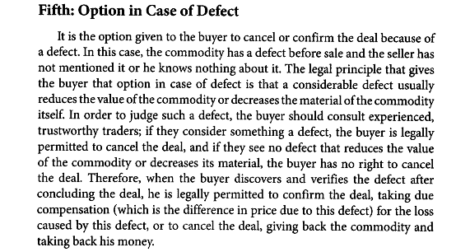
Contract of sale and purchase

Slide 37
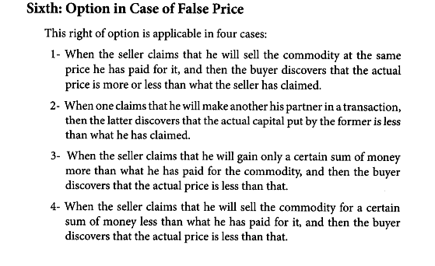
Contract of sale and purchase

Slide 38
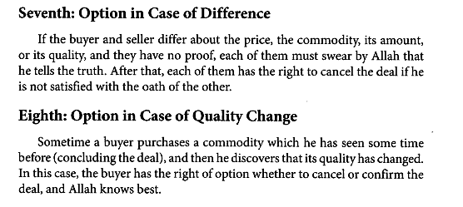
Contract of sale and purchase

Slide 39
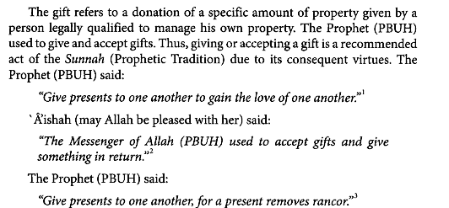
Donative contract

Slide 40
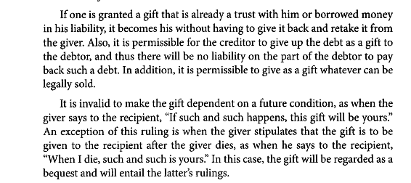
Donative contract

Slide 41
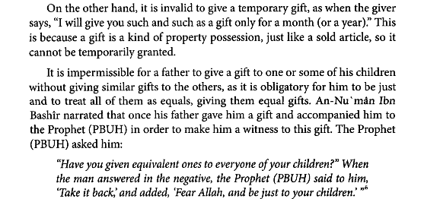
Donative contract

Slide 42
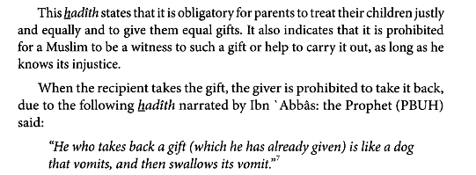
Donative contract

Slide 43
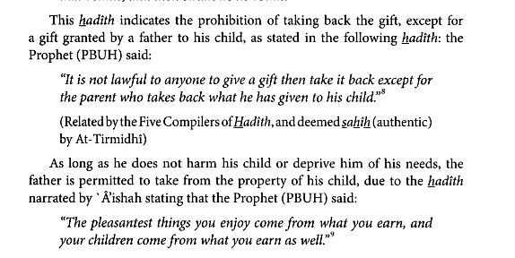
Donative contract

